Slide 1

Infrared alert system with radio frequency capability
T09-Signal SENDERS
Max Cope
Leslie Eide
Chris Klupenger
SignalSenders

Slide 2
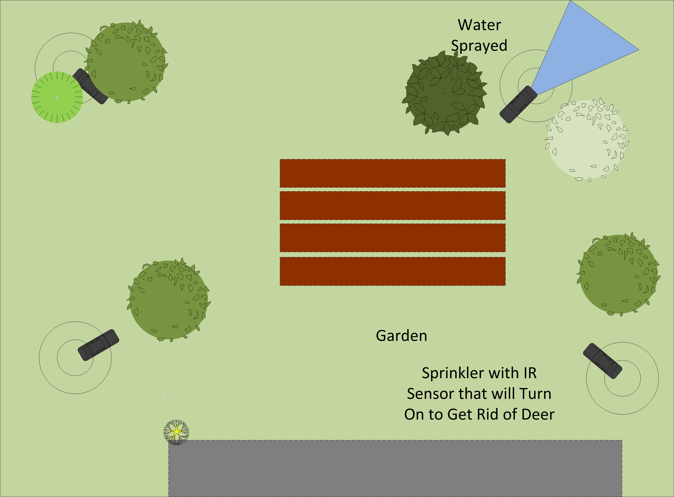
Problem
Practicum project guidelines
Motivation
Originated from sprinklers systems designed to keep deer off property
Communication between units
Issues with scope of project
SignalSenders

Slide 3
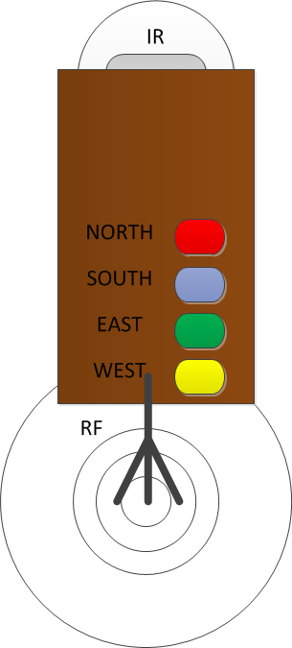
Objective
Develop a security network with communication capabilities between units
Utilize communication within the 2.4GHz ISM band to lessen complexity
Battery operated to eliminate hard wired constrictions
Make a visual LED array to confirm motion on each unit with unique ID
SignalSenders

Slide 4
Alternatives
Wired UNITS
Signal Options
Inefficient at larger areas
Cables everywhere
SINGLE UNITS
One sensor with one receiver
IR Signal
RF Signals
WI-FI
Bluetooth
GFSK 2.4GHz
SignalSenders

Slide 5
Requirements
MOTION SENSOR
With parameters for range and duration of signal
MICROCONTROLLER
Interface between the IR and RF units
Decode received signal to light corresponding LED
RF SIGNAL
Ability to send and receive a signal
Range without interference
UNIT IDENTIFICATION
Controllable unique ID
Used within RF signal and LED identification
SignalSenders

Slide 6
Approach
Activity View
Interaction View
SignalSenders

Slide 7
Design
IDENTIFY
IR Motion Detector
RF Transceiver
Microcontroller
LED Indicators
Housing
SignalSenders

Slide 8
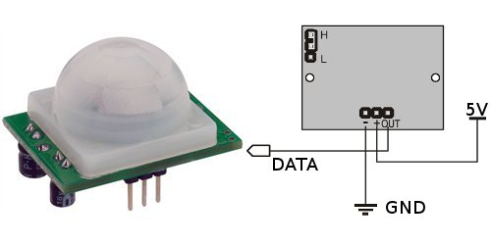
Infrared motion sensor Design
PIR Sensor 555-28027
5V Power
Ground
1 Bit Active High Data Bit
Adjustable Parameters
Sensitivity
Signal duration
SignalSenders

Slide 9
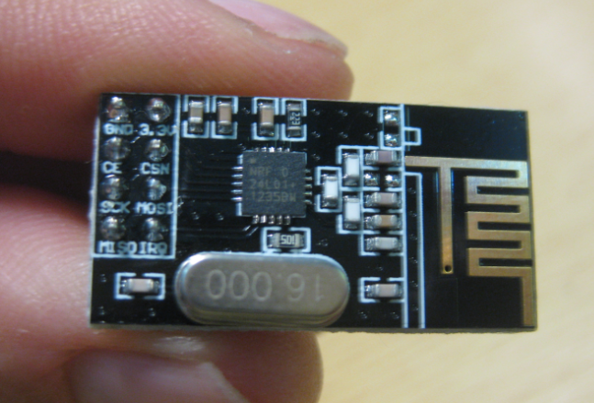
Radio frequency Communication
SPI interfacing with μC
Configurable through programming
“RF24” Libraries
nRF24L01+
Handles all RF tasks
2.4 GHz ISM Band
worldwide license-free
Communication Pipes
A unique pipe for each units communication
Simultaneous unit communication
SignalSenders

Slide 10
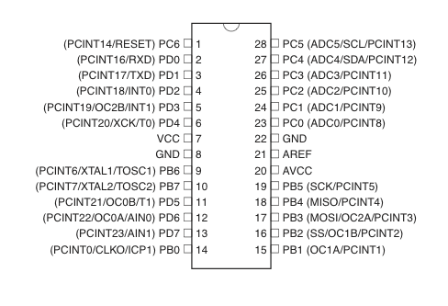
Microcontroller Programming
ATMEGA 328P
Programming
IR Detect
RF SPI
Four LED
Unit Identification
Programmed Through SPI
SignalSenders

Slide 11
LED Output
Four LED Outputs
One LED indicator to represent each unit
All power sourced from μC!
Analog Voltage signal
5 second LED illuminated to Indicate a trip on respective unit
Specified indication time span
HOUSING
Self contained unit
Color coordinated for unit identification
SignalSenders

Slide 12
Algorithm
Main
GET Value on IR in
IF IR Pin High
STOP Listening on RF Module
START Writing on RF Module
SEND Unit ID
START Listening
START Unit LED
BEGIN LED’s timer
IF Radio message available
COLLECT Entirety of message
START Message’s LED
BEGIN LED’s timer
LED Timers
IF LED’s timer is greater than defined interval
Turn LED OFF
ELSE
Keep LED ON

Slide 13
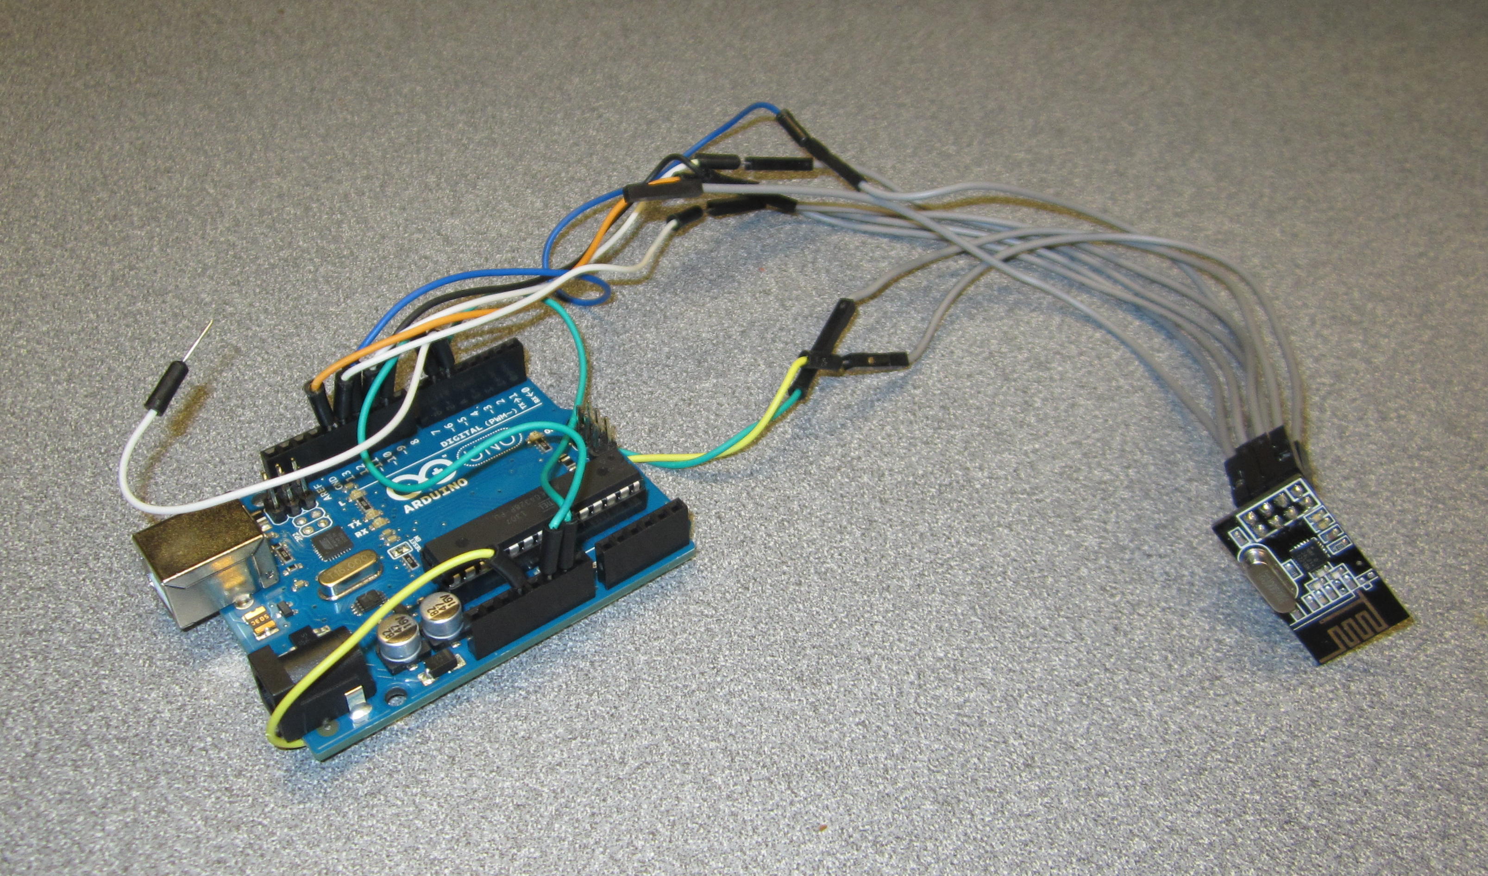
Initial Verification
Subsections of circuit were built and
tested on breadboard independently
Battery power duration
IR Sensor range and sensitivity
RF communication
Microcontroller control
Changes such as digital output pins used, SPI connectivity, etc. stemmed from early verification work

Slide 14
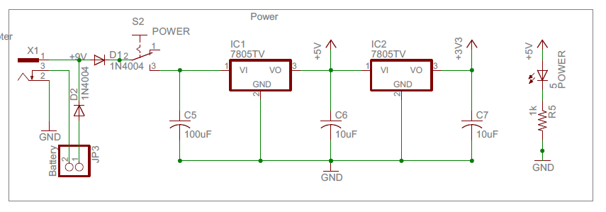
Implementation Schematic - POWER
SignalSenders

Slide 15
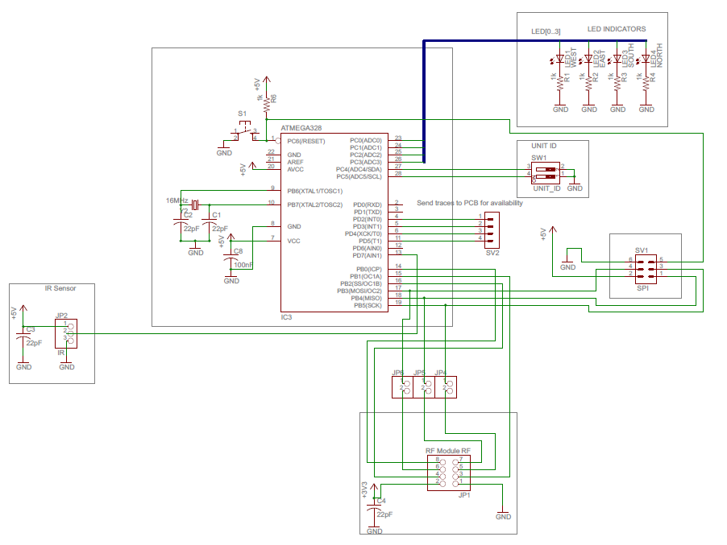
Implementation Schematic – Modules
SignalSenders

Slide 16
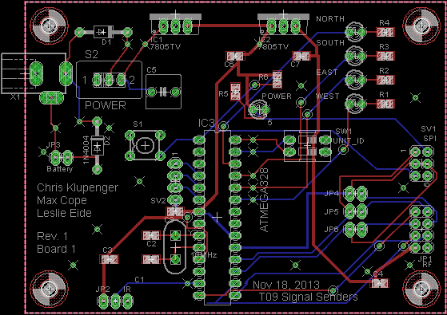
Implementation PCB
SignalSenders

Slide 17
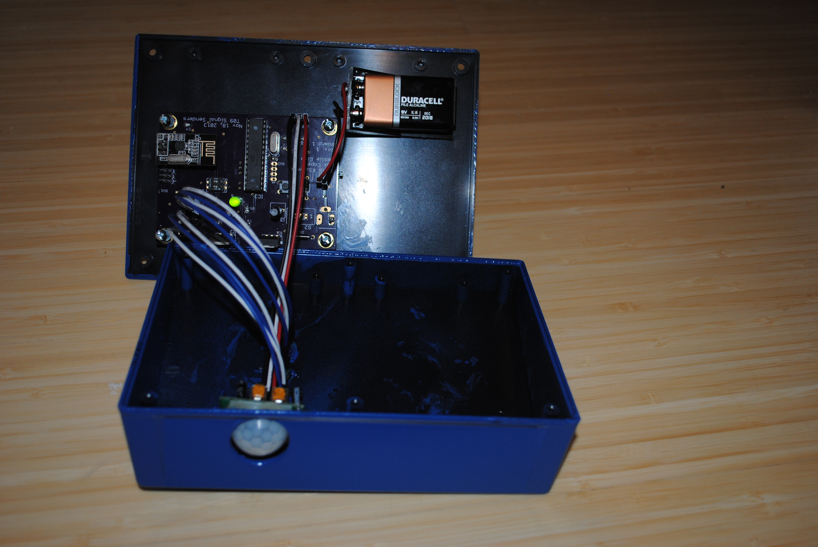
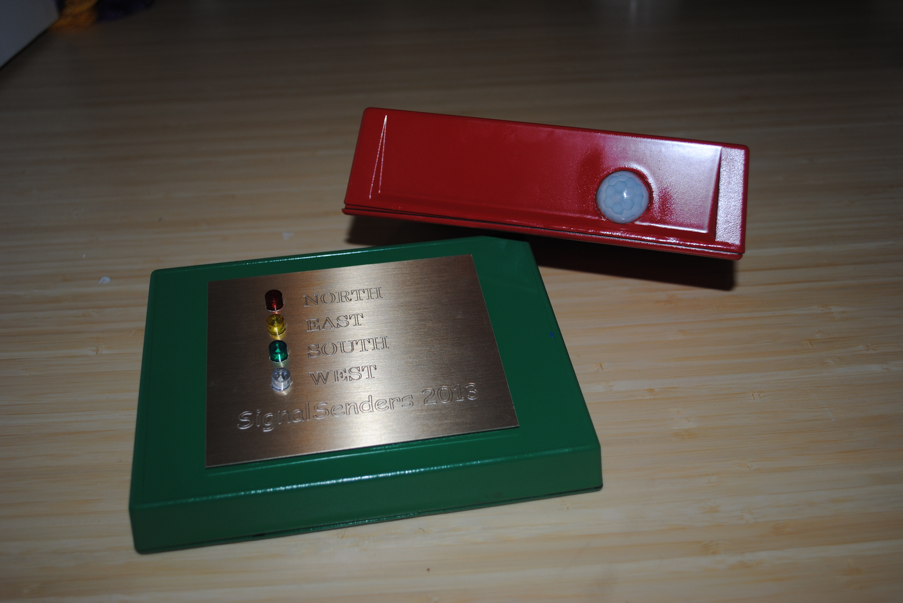
Housings
Self Contained Unit
Mounting board/battery/sensor
Visually Identify unit ID

Slide 18
Intellectual property prior work
RF Module libraries found online
Open source Arduino coding
Nothing proprietary created
No schematics referenced in design
SignalSenders

Slide 19

Testing
Strategy
Execution
Testing power
Continuity
Layering complexity
$4^{4}=256$ combinations
Battery power/interference
Duration LED output
Errors inconsistent/
non-repeatable
SignalSenders

Slide 20
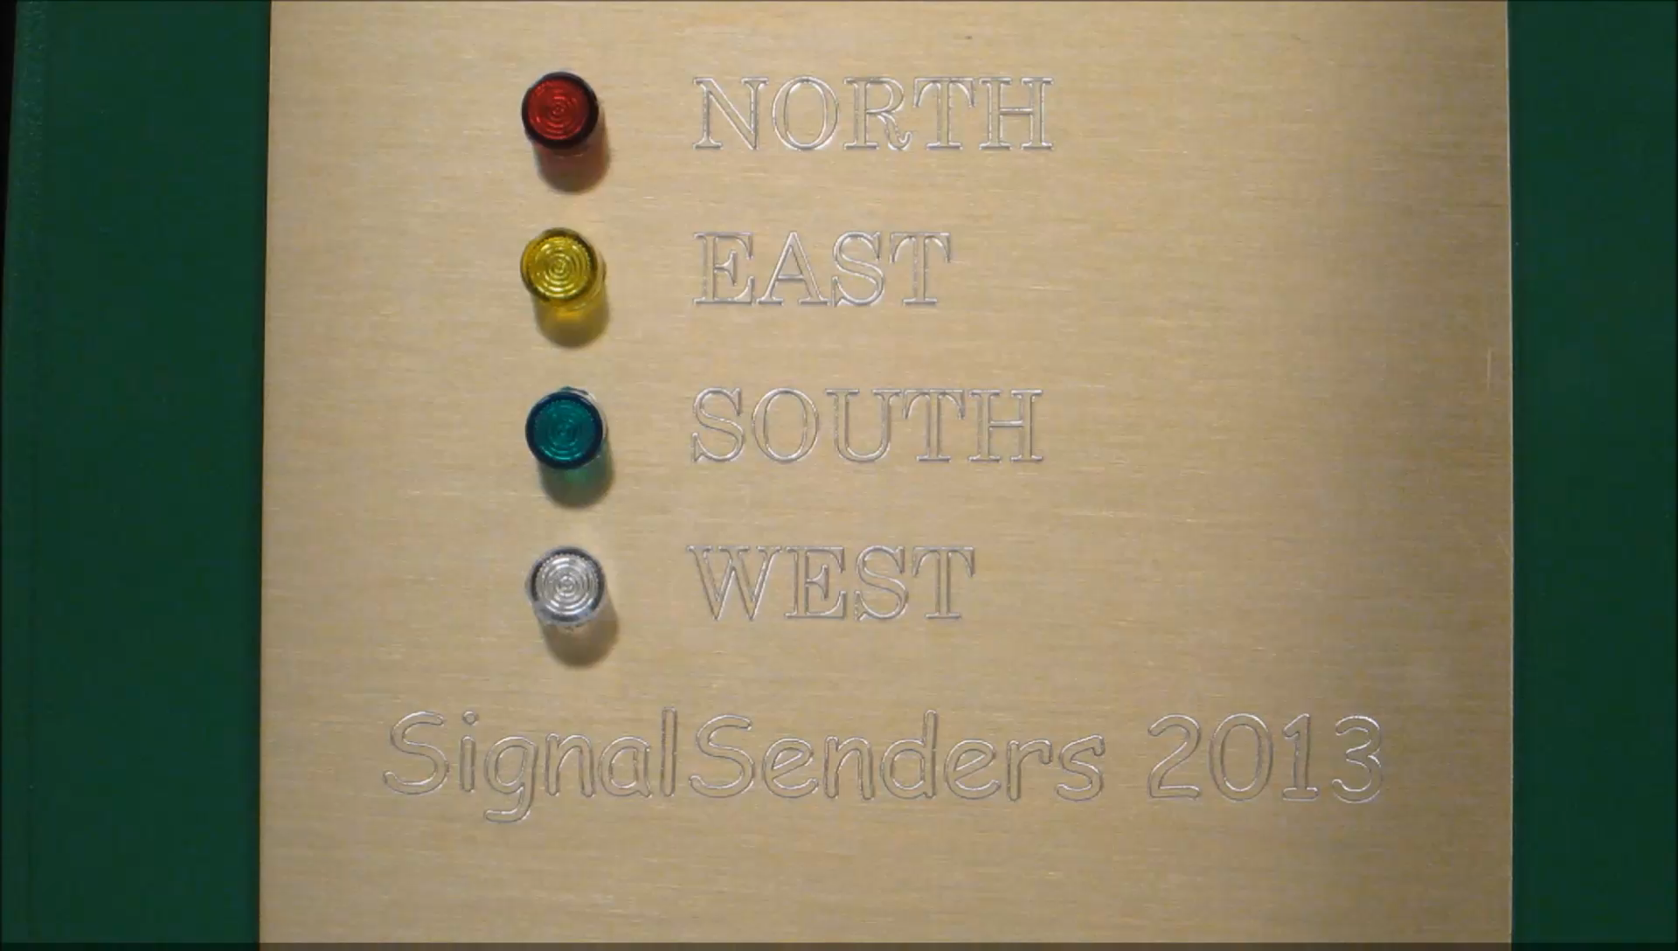
Startup Sequence

Slide 21
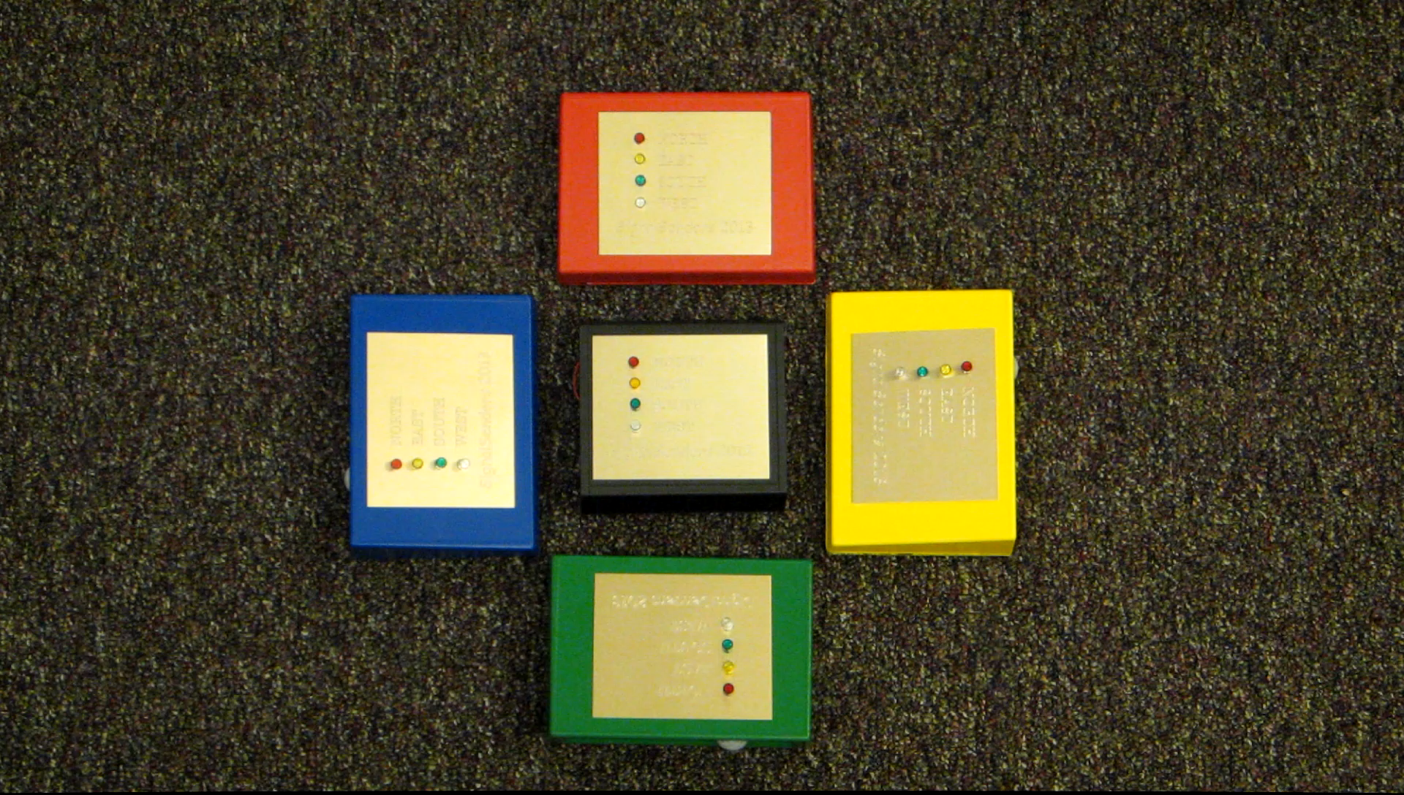
Results
SignalSenders

Slide 22
Contributions
Max cope
Leslie Eide
Chris Klupenger
RF signals
RF Firmware
Eagle BOM Verification
Project Design Specifications
Ordering parts/procurement
Building Boards
IR motion detector
LED output panel
Housing
Eagle Schematic
Scheduling
System Design and Modeling
Building Boards
Microcontroller
Coding
Eagle board layout
Test plan
Programming boards
Building boards
Testing/troubleshooting
SignalSenders

Slide 23
Lessons Learned
SignalSenders

